Slide 1
Schizophrenia

Slide 2
Schizophrenia
Classification of schizophrenia. Positive symptoms of schizophrenia, including hallucinations and delusions. Negative symptoms of schizophrenia, including speech poverty and avolition. Reliability and validity in diagnosis and classification of schizophrenia, including reference to co-morbidity, culture and gender bias and symptom overlap.
Biological explanations for schizophrenia: genetics and neural correlates, including the dopamine hypothesis.
Psychological explanations for schizophrenia: family dysfunction and cognitive explanations, including dysfunctional thought processing.
Drug therapy: typical and atypical antipsychotics.
Cognitive behaviour therapy and family therapy as used in the treatment of schizophrenia. Token economies as used in the management of schizophrenia.
The importance of an interactionist approach in explaining and treating schizophrenia; the diathesis-stress model.

Slide 3
Classification of schizophrenia. Positive symptoms of schizophrenia, including hallucinations and delusions. Negative symptoms of schizophrenia, including speech poverty and avolition. Reliability and validity in diagnosis and classification of schizophrenia, including reference to co-morbidity, culture and gender bias and symptom overlap.

Slide 4
Classification of schizophrenia
Schizophrenia: A psychosis characterised by a profound disruption of cognitive and emotion.
  Affects 1% of the world’s population
  Those with the illness believe what they see is normal
  More commonly diagnosed in: males than females; cities than countryside, working class than middle class
  Can severely impact someone's ability to function and can lead to hospitalisations and homelessness
  Diagnosing schizophrenia: using DSM (US) and ICD (European)

Slide 5
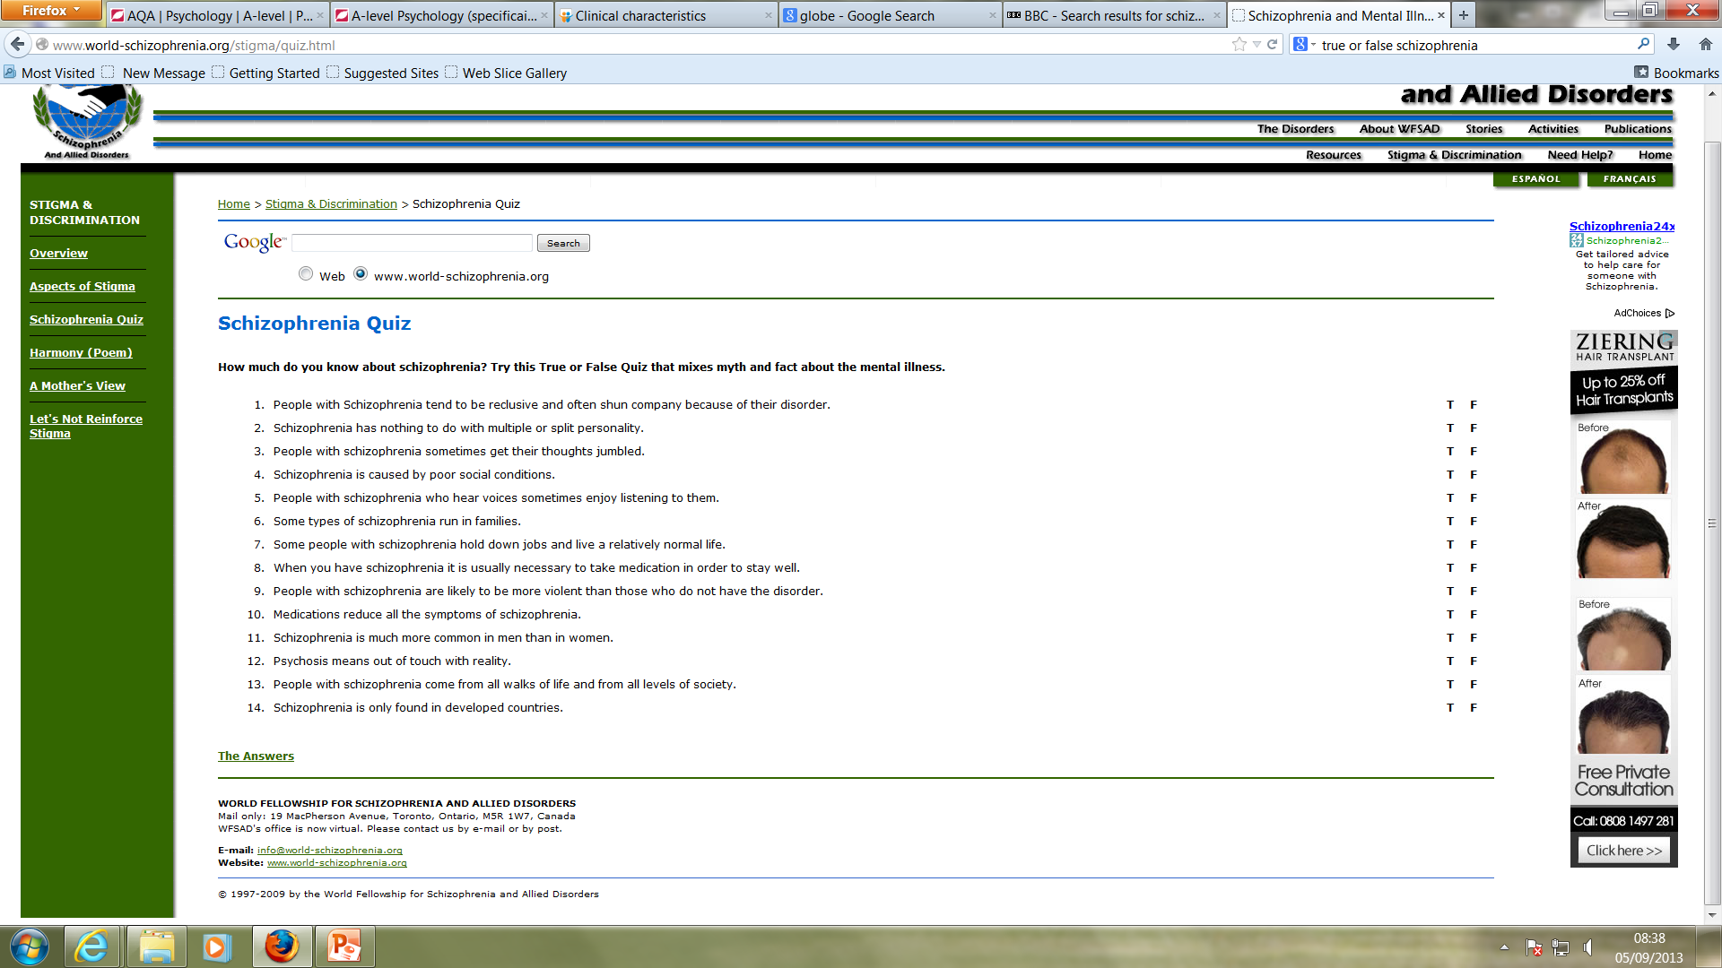
True or False
T
T
T
F
T
T
T
T
F
F
T
T
T
F
Notes:
http://www.bbc.co.uk/news/health-23880152
T
T
T
F
T
T
T
T
F
F
t
T
T
F

Slide 6

What is it?
Schizophrenia is not, as many people think, a split personality.
⬇
The term comes from two Greek words: ‘schizo’, meaning ‘split’, and ‘phrena’ meaning ‘mind’
The ‘split’ in schizophrenia occurs between a person’s thought processes and reality.

Slide 7
Definition
Schizophrenia is a severe mental illness where contact with reality and insight are impaired, an example of psychosis
It is characterized by incoherent or illogical thoughts, bizarre behavior and speech, and delusions or hallucinations.
How is Schizophrenia often portrayed in the media?
Notes:
http://www.dailymail.co.uk/news/article-3135955/Paranoid-schizophrenic-beheaded-great-grandmother-not-guilty-reason-insanity.html

Slide 8
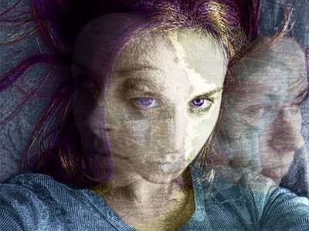
A ‘psychosis’
Psychosis is a term used to describe a severe mental health problem where the individual loses contact with reality (unlike neurosis where the individual is aware that they have problems)
About 25% of sufferers will get better after only one episode of the illness; 50-65 % will improve, but continue to have bouts of the illness. The remainder will have persistent difficulties (Stirling and Hellewell, 1999)

Slide 9

Classification
There are a number of systems by which we can classify abnormal patterns of thinking, behaviour and emotion into mental disorders. These systems not only classify abnormality, but give guidance on how to diagnose them
The two most widely used systems of classification and diagnosis are ICD and DSM
ICD: International Classification of the Causes of Disease and Death (World Health Organisation) – recognises a range of subtypes
DSM: Diagnostic and Statistical Manual of Mental Disorder (American Psychiatric Association) – used to also recognise the subtypes but the most recent DSM-5 have dropped these.

Slide 10
Positive Symptoms
an excess or distortion of normal functions: including hallucinations and delusions.
Hallucinations are usually auditory or visual perceptions of things that are not present. Imagined stimuli could involve any of the senses. Voices are usually heard coming from outside the person’s head giving instructions on how to behave.
Delusions are false beliefs. Usually the person has convinced him/herself that he/she is someone powerful or important, such as Jesus Christ, the Queen (e.g. Delusions of Grandeur). There are also delusions of being paranoid, worrying that people are out to get them.
Psychomotor Disturbances: Stereotypical – Rocking backwards and forwards, twitches, & repetitive behaviours.
Catatonia- staying in position for hours/days on end, cut off from the world.

Slide 11
Negative Symptoms
where normal functions are limited: including speech poverty and avolition.
Thought disorder in which there are breaks in the train of thought and the person appears to make illogical jumps from one topic to another (loose association). Words may become confused and sentences incoherent (so called ‘word salad). Broadcasting is a thought disorder whereby a person believes their thoughts are being broadcast to others, for example over the radio or through TV. Alogia – aka speech poverty – is a thought disorder were correct words are used but with little meaning.
Avolition: Lack of volition (i.e. desire): in which a person becomes totally apathetic and sits around waiting for things to happen. They engage in no self motivated behaviour. Their get up and go has got up and gone!

Slide 12
Recap
The specification specifically names co-morbidity, culture and gender bias as well as symptom overlap when we talk about reliability and validity - but what is reliability and validity?
  Reliability: Measures consistency. It is about the extent to which psychiatrists can agree on the same diagnoses when independently assessing patients.
  Validity: Is all about measuring what you want to measure, in our case how accurate diagnosis for schizophrenia is. If you create a test that does not measure schizophrenia then it is not valid.
These two go hand in hand, if a test is unreliable and keeps coming up with different conclusions when repeated then it cannot be valid (and vice versa).

Slide 13
In parts of the world the DSM diagnostic tool is used while other parts may use the ICD tool to diagnose Schizophrenia.
Issues with reliability first arise as both these tools have different diagnostic criteria’s; for example the DSM tool previously recognised 5 sub-types of schizophrenia while the ICD tool recognised 7 subtypes. Although now updated, this means diagnosis was not consistent between different parts of the world dependent on the tool being used. This means one country may have diagnosed someone as normal while another place with the same symptoms may see them as Schizophrenic. Therefore there is a clear cultural bias dependent on which identification tool is being used and where the individual is in the world highlighting how inconsistent and unreliable diagnosis actually is. This raises ethical concerns particularly when you consider the stigmatisation that follows a diagnosis of a mental disorder.
Cultural issues have contributed to significant variation between countries when it comes to the diagnosis of schizophrenia even when using the same criteria. Copeland (1971) gave 134 US and 194 British psychiatrists a description of a patient. 69% of US psychiatrists gave a diagnosis of schizophrenia while only 2% of British psychiatrists concluded the same highlighting issues with consistency and reliability.
In Britain people of Afro-Caribbean descent are more likely to be diagnosed as schizophrenic when compared to people who are white again highlighting diagnosis may not be valid. It could be argued the stress ethnic minority groups face contributes to this increased risk or that diagnosis itself is invalid. The fact that diagnosis is not consistent raises the issue of validity as we clearly cannot define schizophrenia correctly for a reliable diagnosis.
Gender bias in diagnosis is another issue although the accepted belief is that males and females are equally vulnerable to developing schizophrenia. Some argue that clinicians, most of which are men, misapply the diagnostic criteria to women and research findings show 50% more male sufferers due to this gender bias when diagnosing patients. Clinicians also fail to consider that males tend to suffer more negative symptoms than women and have higher levels of substance abuse while females have better recovery and relapse rates. Males and females also tend to have different predisposing factors giving them different vulnerability levels at different points in life and this is another factor clinicians tend to ignore contributing to this gender bias.
Gender differences in classification of the disorder occurs too, with first onset occurring earlier in males between the ages of 18 and 25. In females first onset is generally 4 and 10 years later between the ages of 25 and 35 years and this under-diagnosis and difference between genders highlights the lack of validity in diagnosis.
Symptom overlap is another issue affecting reliability and validity. Many of the positive and negative symptoms of schizophrenia are found in many other disorders such as depression and bipolar disorder. Ellason and Ross (1995) highlight how people with dissociative identity disorder (DID) actually have more schizophrenic symptoms than those diagnosed with schizophrenia themselves. Read (2004) also argued that most people with schizophrenia actually have enough symptoms that overlap with other disorders that they could receive one other diagnosis. This again calls into question the validity of both the classification and diagnosis of schizophrenia suggesting it may not be different to bipolar disorder or DID.
Co-morbidity is another issue undermining reliable diagnosis. This is when one or more additional disorders or diseases occur simultaneously with schizophrenia and this can affect reliable diagnosis as confusion arises over which disorder is being diagnosed. Schizophrenics often suffer from various forms of depression and this raises the issue of descriptive validity as having simultaneous disorders suggests schizophrenia may not be a separate disorder itself.

Slide 14
Pseudopatients
David Rosenhan (1973) famous experiment involving Pseudopatients led to 8 normal people being kept in hospital despite behaving normally.
This suggests the doctors had no valid method for detecting schizophrenia. They assumed the bogus patients were schizophrenic with no real evidence. In a follow up study they rejected genuine patients whom they assumed were part of the deception.

Slide 15
Research
Sim et al (2006) reported that of 142 hospitalised schizophrenics, 32% had an additional mental disorder highlighting the problem co-morbidity can create in achieving a reliable and valid diagnosis. Jeste er al (2009) stated that schizophrenics with co-morbid conditions are excluded from research yet form the majority of patients. This suggests research findings into the causes of schizophrenia cannot be generalised to most sufferers. This also has a knock-on effect in terms of the treatments sufferers should receive.

Slide 16
research
Fernando (1988) argued that people from ethnic minorities experience greater levels of racism, prejudice, poverty and racism than the white population and these stressors trigger schizophrenia and explained cultural biases so should be expected in diagnosis. However Cochrane (1983) highlighted how it was only the Afro-Caribbean people who were more likely to be diagnosed and one possible explanation proposes the diagnosis of the disorder is valid but people of this background have little immunity to the flu (an illness common in Britain but not their country of origin). Children born to mothers who had the flu while pregnant have an 88% increased chance of developing schizophrenia which would explain higher levels of diagnosis in Afro-Caribbean people.

Slide 17
Culture
Culture – One of the biggest controversies in relation to classification and diagnosis is to do with cultural relativism and variations in diagnosis. For example in some Asian countries people are not expected to show emotional expression, whereas in certain Arabic cultures public emotion is encouraged and understood. Without this knowledge a person displaying overt emotional behaviour in a Western culture might be regarded as abnormal. Cochrane (1977) reported that the incidence of schizophrenia in the West Indies and the UK is 1 %, but that people of Afro-Caribbean origin are seven times more likely to be diagnosed as schizophrenic when living in the UK.

Slide 18
Questions
Q1. Explain how symptom overlap might lead to problems with the diagnosis and / or classification of schizophrenia. (Total 2 marks)
Q2. In the context of schizophrenia, outline what is meant by co-morbidity. (Total 2 marks)
Q3. Discuss issues associated with the classification and / or diagnosis of schizophrenia. (Total 16 marks)

Slide 19
Q1
Possible content:
• shared symptoms could lead to an unreliable / incorrect diagnosis (not valid)
• because the person may exhibit a symptom typical of schizophrenia (e.g. delusions) but could instead have another condition with the same symptom (e.g. bipolar disorder).

Slide 20
Q2
Possible content:
co-morbidity is where two conditions co-exist in the same individual at the same time / have a tendency to co-exist alongside each other
so a person with schizophrenia might also at the same time be suffering from another condition, e.g. personality disorder, depression, alcoholism, etc.

Slide 21
Q3
AO1 Credit is awarded for description of issues concerned with classification and diagnosis of schizophrenia, most of which are related in some way to reliability and validity. Some issues are specifically relevant to schizophrenia eg the range of symptoms / sub-types of schizophrenia and the difficulty of distinguishing between them. Reference may be made to co-morbidity, culture and gender bias. Other issues surrounding the classification and diagnosis of mental disorders in general can receive credit as long as they are made relevant to schizophrenia.
AO3 Discussion should be of the issues identified when classifying and / or diagnosing schizophrenia. Answers should evaluate and offer commentary on the issues they have identified, for example by considering the consequences arising from the issue. Answers may include discussion of advantages of using classification systems in relation to effective treatment programmes and support and / or problems associated with classification and diagnosis. For example, diagnosis might lead to labelling and stigmatisation (Scheff 1966) causing long-term problems of getting / keeping employment and leading to a self-fulfilling prophecy

Slide 22
Video

